Slide 1
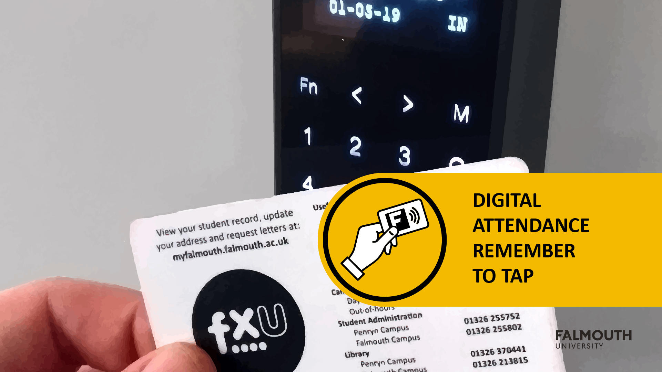

Slide 2



Slide 3
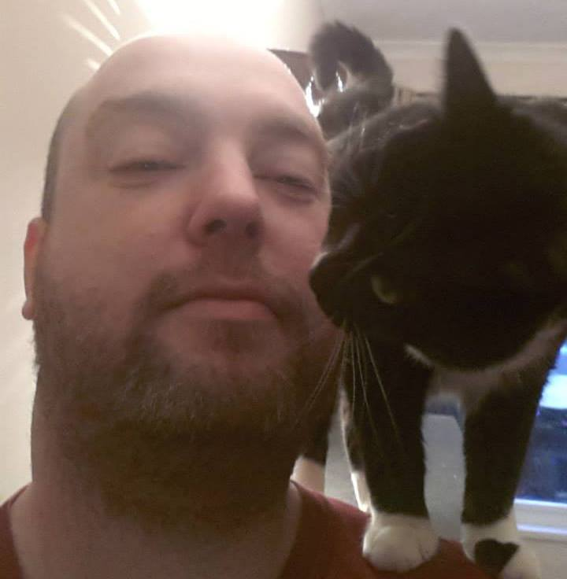
Brian McDonald
- Programming and Development
Brian is a keen advocate for the Games Development Community. He was elected to serve on the board of IGDA Scotland from 2013 - 2016. In this role he helped bring together the Game Developers from around Scotland by organising monthly meetings and developer talks.
brian.mcdonald@falmouth.ac.uk

Slide 4
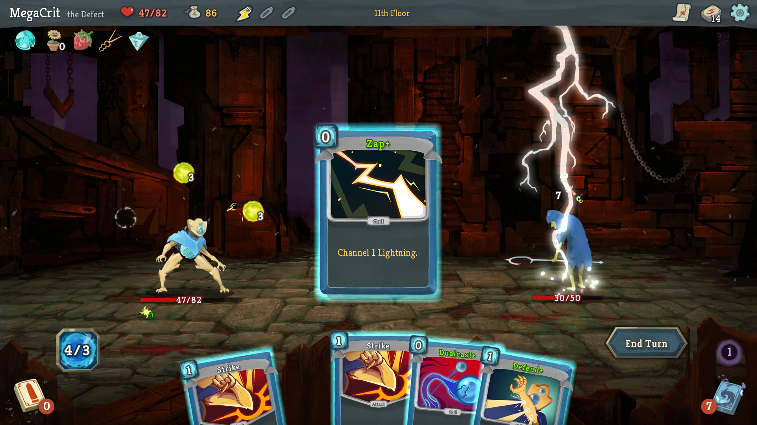

Slide 5

Module
Aims
https://learningspace.falmouth.ac.uk/mod/page/view.php?id=49032
Please check the award maps for more details on this structure

Slide 6
Module AIMS
To deepen your knowledge and understanding of ‘world’ and intellectual property development in an enterprise context

Slide 7
More Broadly
Work in a MULT—SKILLED Team to develop a game based on a ‘WORLD’ Concept
The module will include
world-building
exploratory concept work
Prototyping
pre-production, and early phases of production
With Feedback from your Tutors you will use Agile practices to develop your game
By the end of the module, your game should be at an alpha stage of development

Slide 8
What is ALPHA?
Take a game to Alpha
“Alpha is the stage when key gameplay functionality is implemented, and assets are partially finished” - Heather Maxwell Chandler, The Game Production Handbook
For example: if your game has four levels, we want to see all four part-finished, not two beautifully polished and two that are absent / unplayable!
Remember – the games you play at home are finished. The games you make are work-in-progress. #blocktober

Slide 9
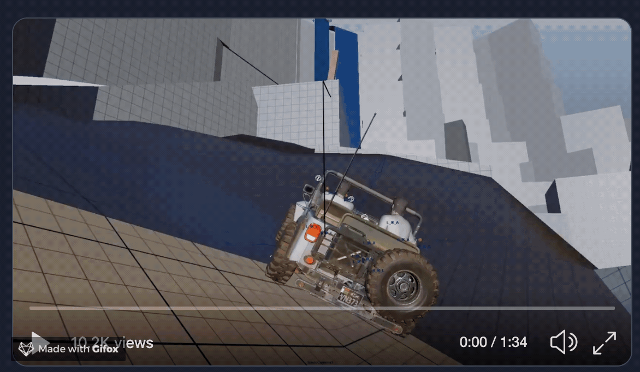

Slide 10
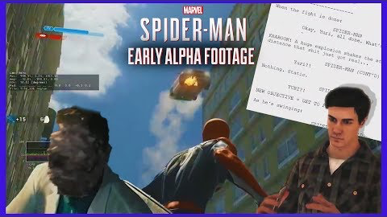

Slide 11
Learning Outcomes
ID | NAME | DESCRIPTION | ASSESSMENT CRITERIA CATEGORY
7 | Collaborate | Use appropriate development practices, project tracking approaches, and tools to support development pipelines in a multidisciplinary team. | COLLABORATION
2 | Implement | Apply the use of specialisms into development workflows and contexts. | INDUSTRY
8 | Pitch | Analyse existing artefacts to identify opportunities, highlight unique features that would fill a gap, and define routes to audiences. | COMMUNICATE

Slide 12
Assignments
https://learningspace.falmouth.ac.uk/course/view.php?id=3952 Please check learning space for full details

Slide 13
Assignment 1 – game Pitch
This will take place around week 5 (please check myfalmouth for actual dates!)
you will pitch your group’s chosen game concept and Unique Selling Points (USPs) to staff for formative feedback.
The pitch will last 15 minutes
With an additional 5 minutes for questions.
You will be marked on clarity, market research, ability to communicate, and use of materials.

Slide 14
Assignment 1 – game Pitch
The pitch can be structured in whatever way you think is best, but you should ensure that the following sections are covered:
Game concept & core features
The world in which your game is set
USPs / value propositions (what differentiates your game from similar titles)
Commercial viability, including market awareness and appreciation of project scope

Slide 15
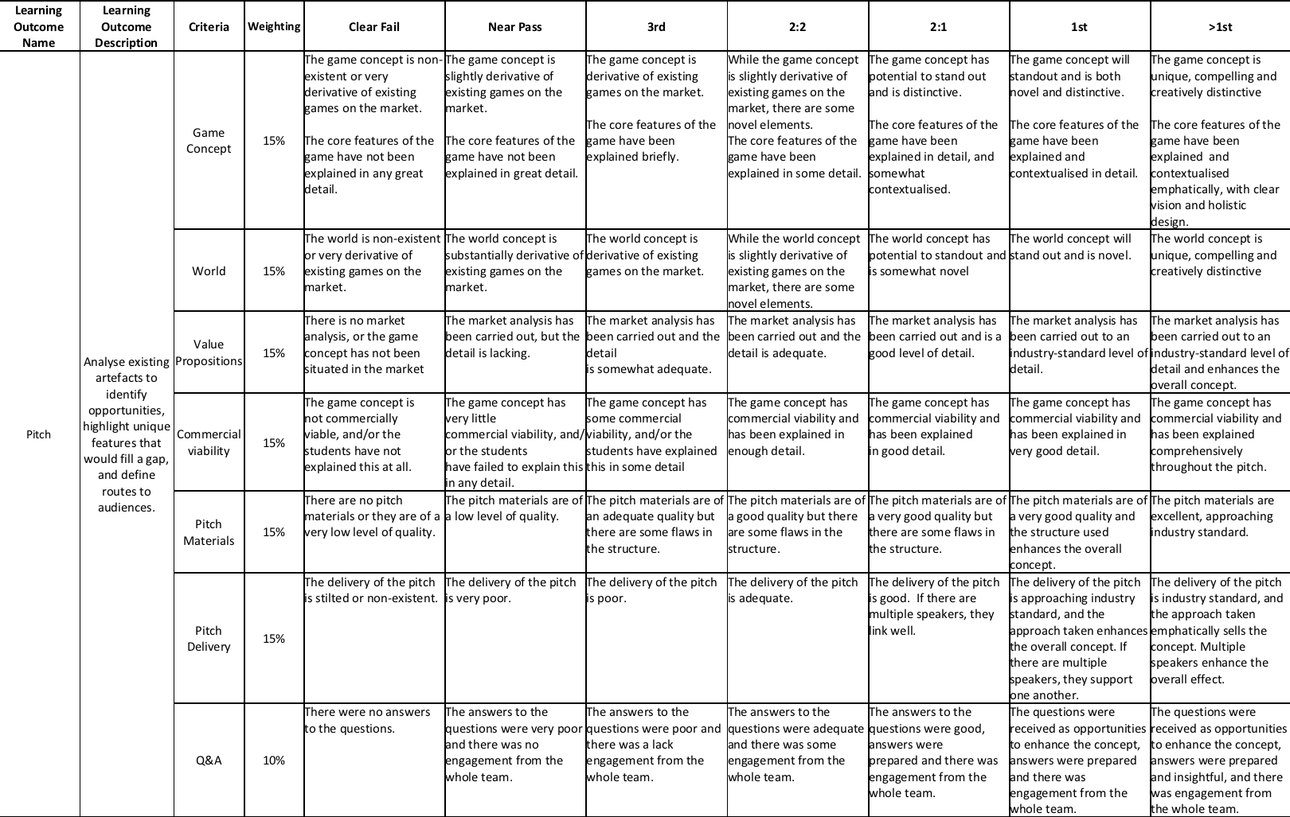
Assignment 1 – game Pitch MArking

Slide 16
game Pitch – things to note
All members of the team must be present for the pitch but not everybody has to speak.
It is recommended that you select a small number of team members who are best able to deliver.
while all other team members are on hand and ready to answer specialist questions if and when they come up.

Slide 17
Assignment 2 – Studio Practice
For this assignment you will develop a game to alpha stage as part of a team and be assessed both in terms of your individual contribution and your team’s performance
This assignment is comprised of multiple parts:
World Pitch
Supervisor Meetings
Studio Practice
Demo day

Slide 18
Assignment 2 – Studio Practice
WORLD pitch – Week 1
10% of your overall grade for this assignment
Supervisor meetings
Attend the scheduled weekly team meeting with your project supervisor.
There are two types of project meeting:
A project review / planning session - Your team will showcase work undertaken on the most recent sprint and then plan the next sprint
An individual review - You and your teammates will review each other’s approaches to work over the last sprint
Starts from Week 3!

Slide 19
Assignment 2 – Studio Practice
Studio Practice
You will work as a team in timetabled sessions
There will be members of staff on hand to lend support
Please ask for specialist support in these sessions
Staff will be assigned to assess your game
Demo day
Held during Week 13
Each team will need to make a demo of their game available in the Games Academy for staff to play

Slide 20
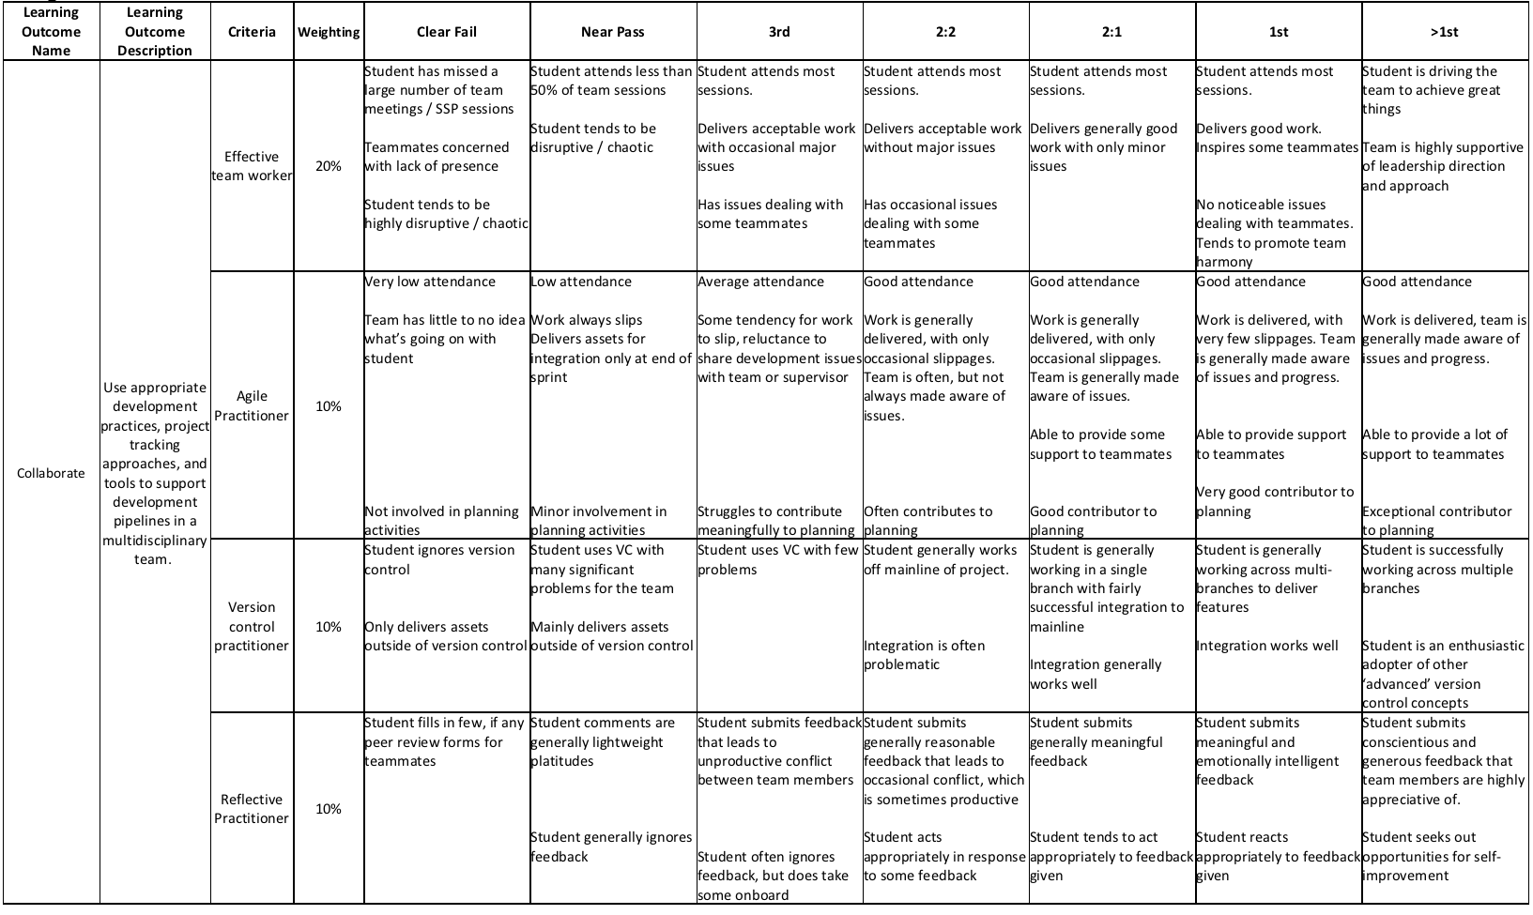
Assignment 2 – Studio Practice marking

Slide 21
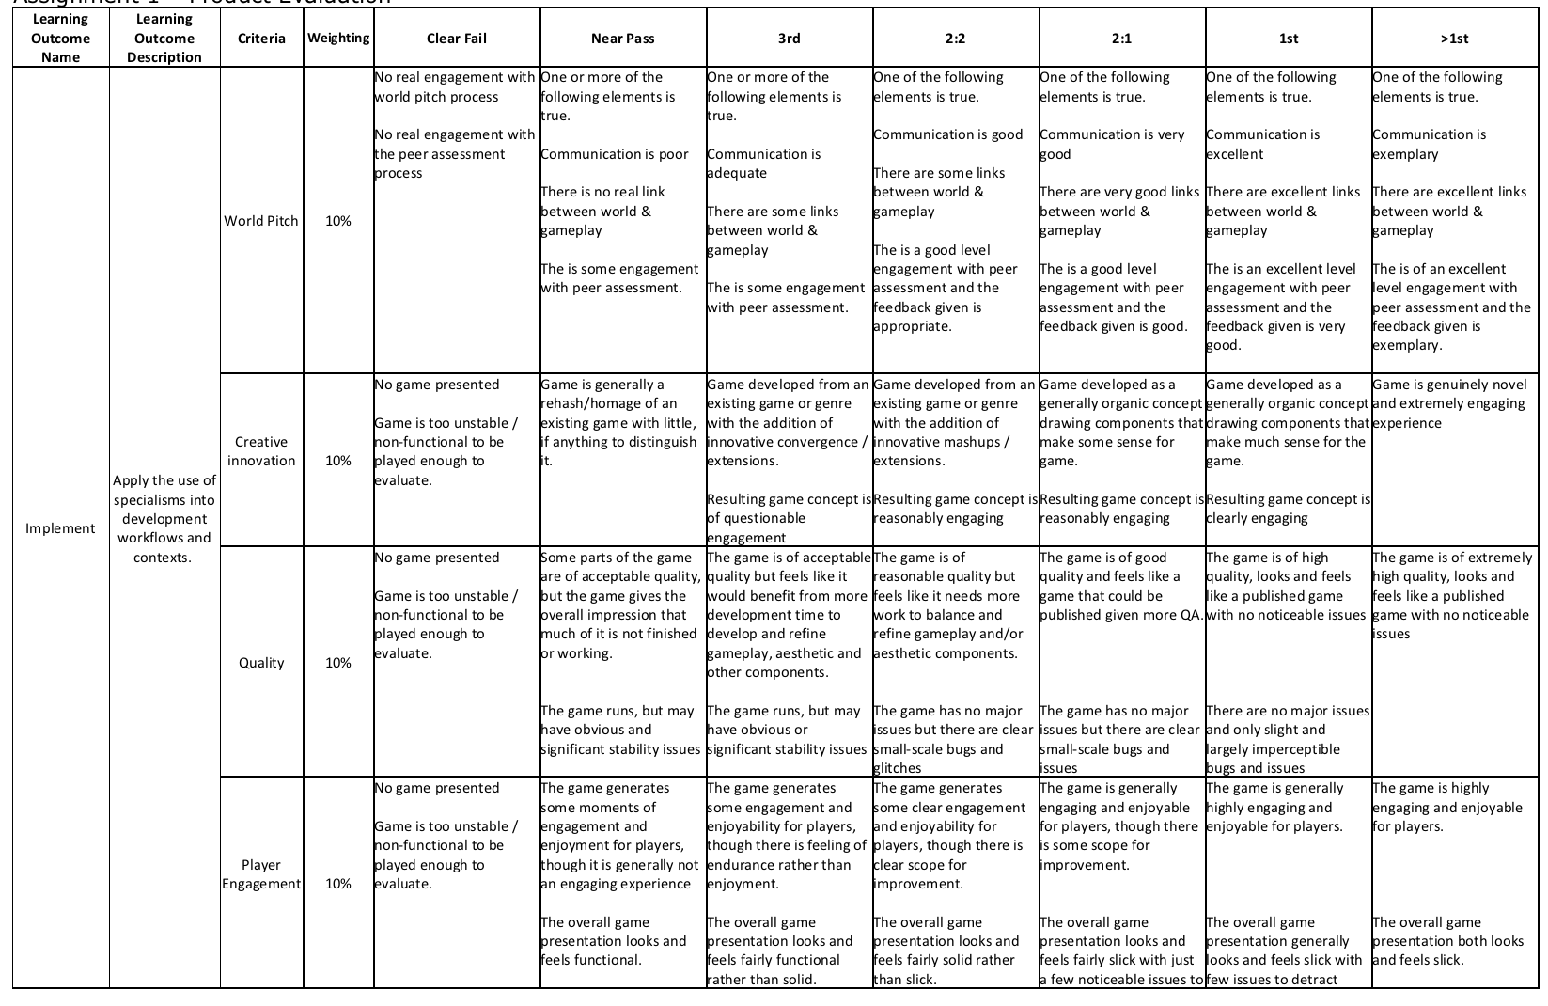
Assignment 2 – Studio Practice marking

Slide 22
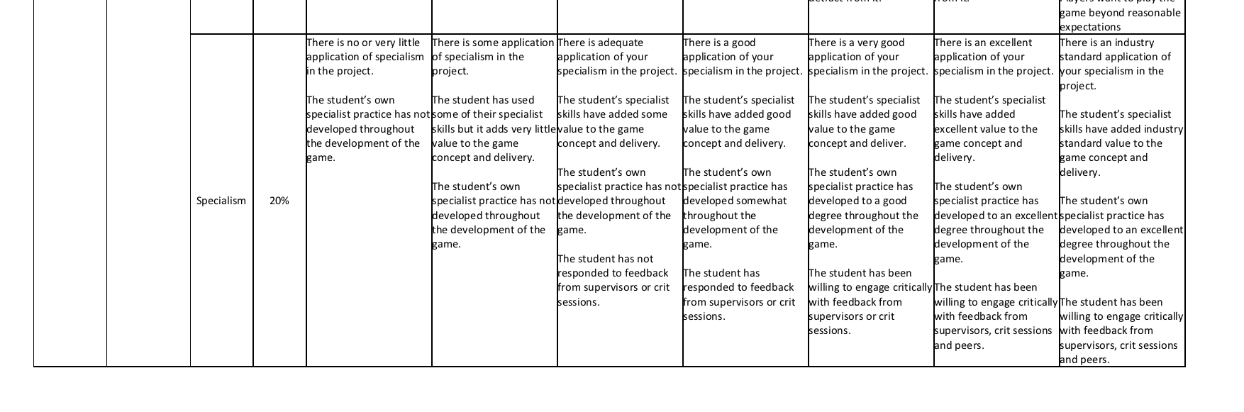
Assignment 2 – Studio Practice marking

Slide 23
Studio Practice – things to note
Product owners are now supervisors
There will be a game health check in week 8
Replaces the normal supervisor meeting
This is a chance for supervisors to see your progress
You will have to pitch your game
Supervisors can flag up issues in your game or even ask you to go back to the drawing board
You can however defend your game and convince us to back it!

Slide 24
Studio Practice – things to note
Supervisor meetings are assessed and you will be marked on each sprint
You should always turn up with a working build
you can also show off artwork and works in progress
Marks for sprints will be normalised at the end of demo day

Slide 25
Agile
Practice
https://learningspace.falmouth.ac.uk/mod/resource/view.php?id=50269
Check out the Agile guide for more details

Slide 26
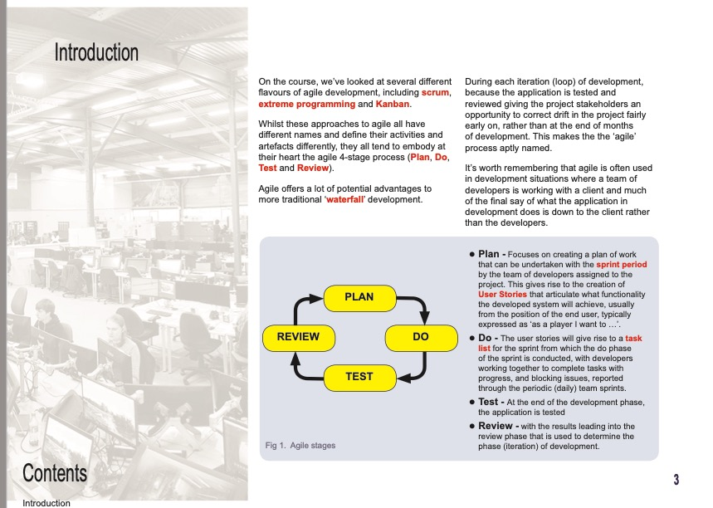
AGILE guide

Slide 27
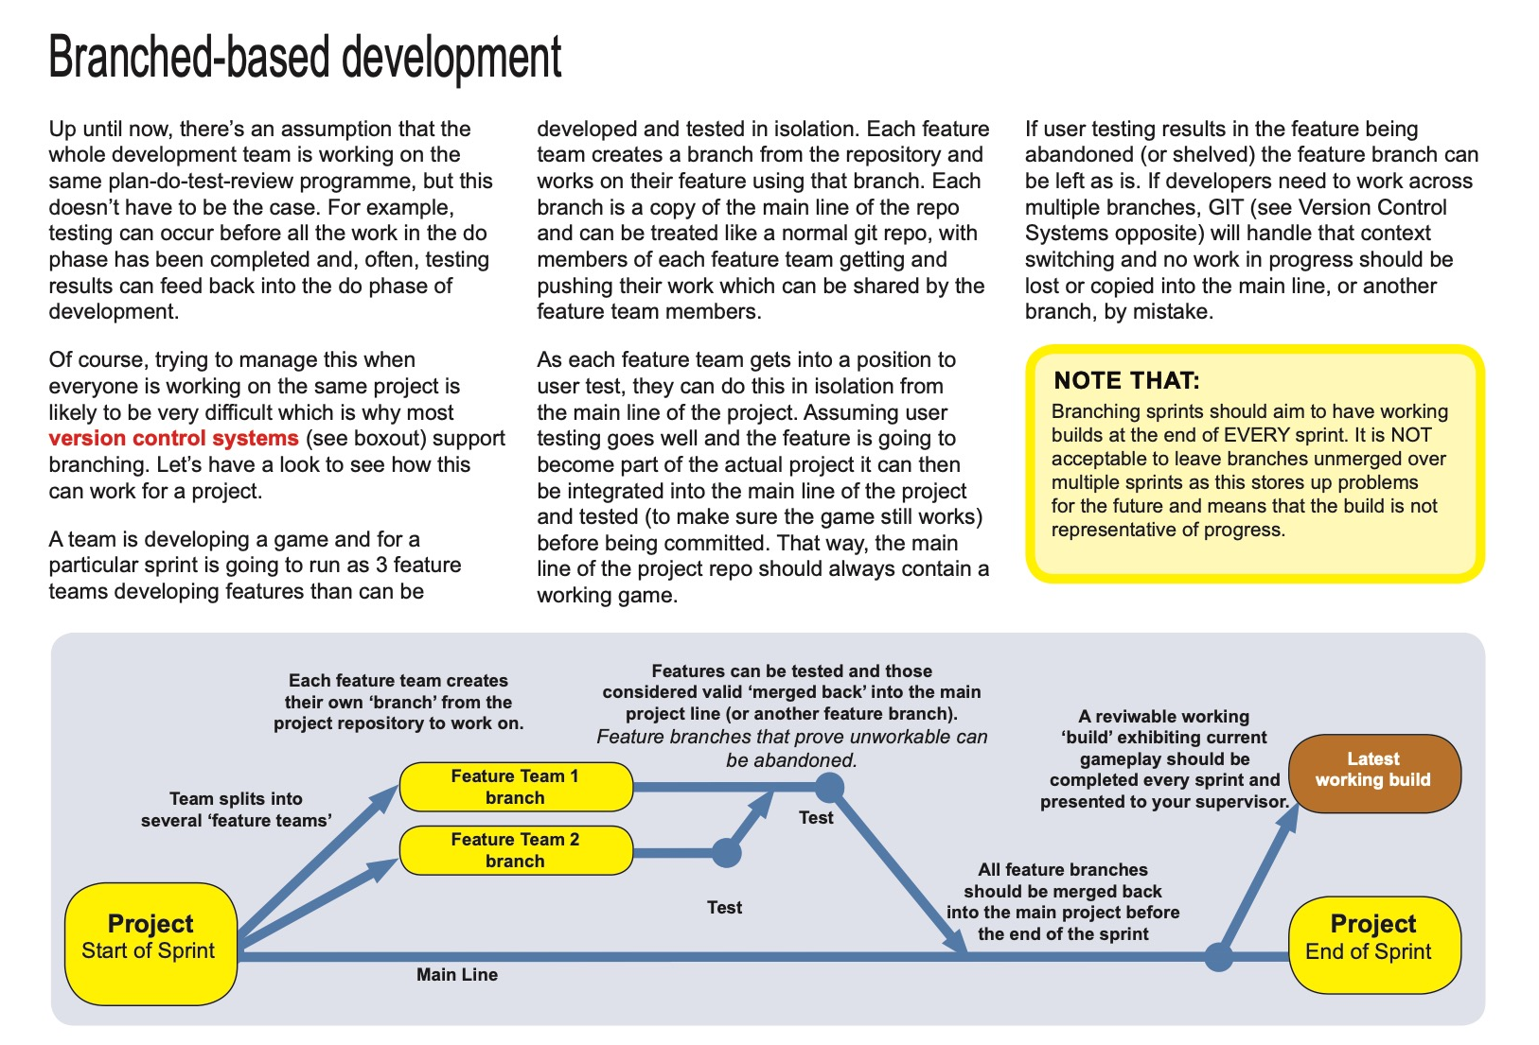
AGILE guide

Slide 28
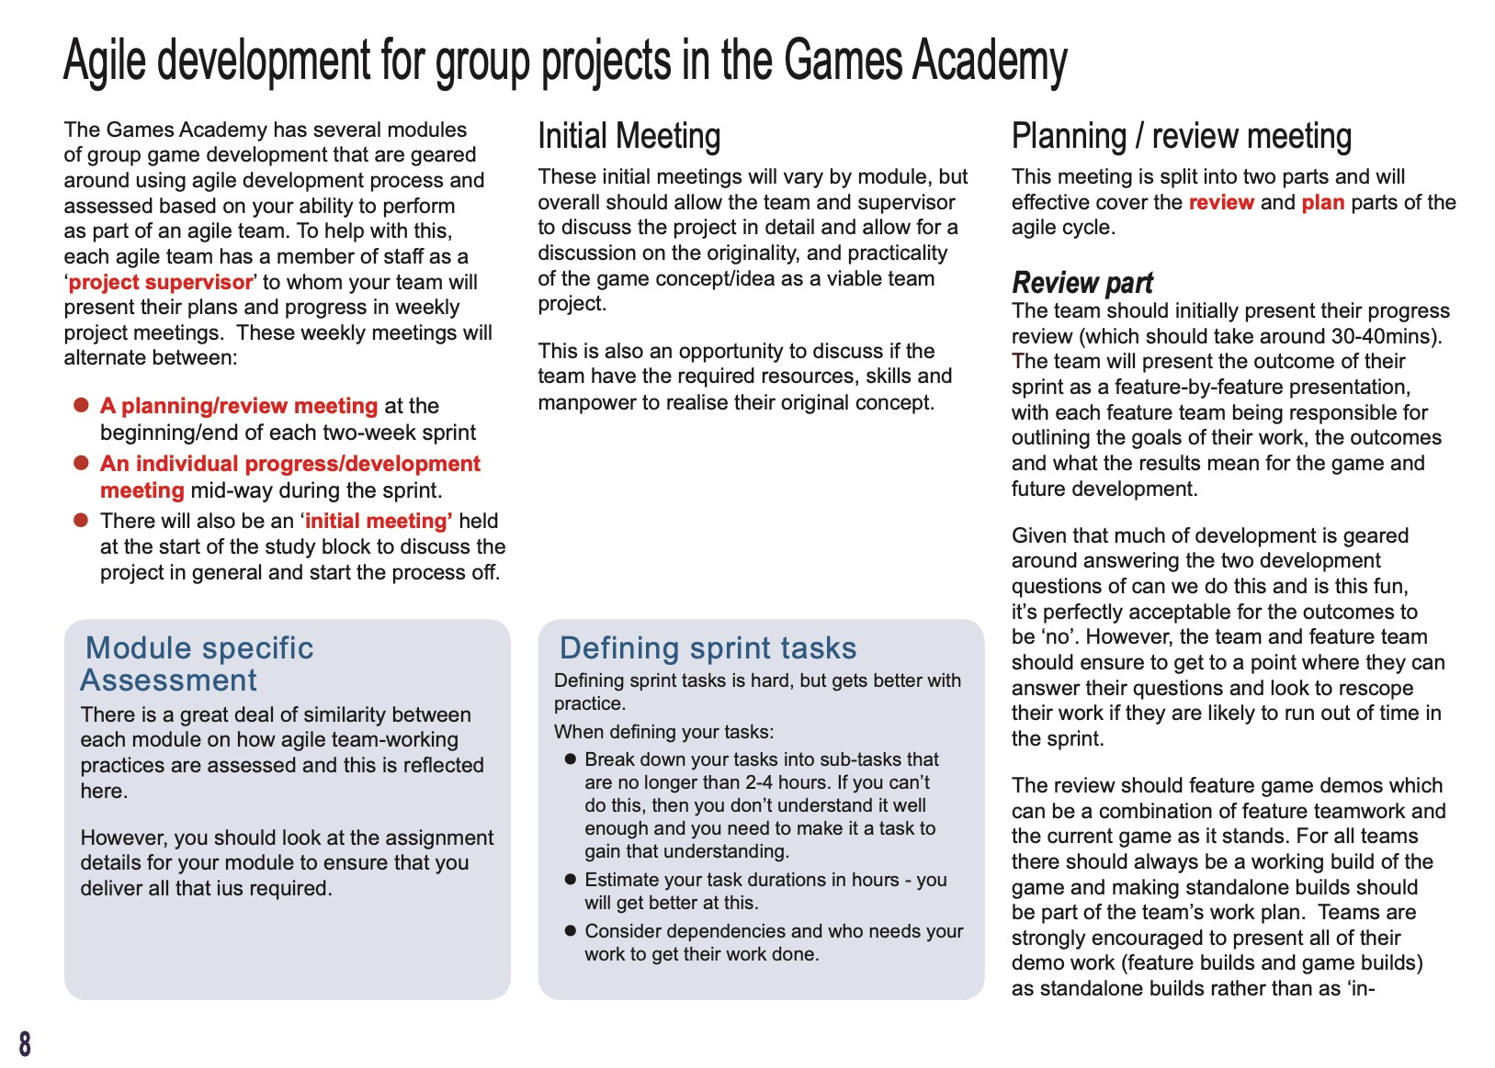
AGILE guide

Slide 29
Play Testing

Slide 30
Playtesting focus
During supervisor meetings we will be asking about play test plans and results
In GAM210 – Theory
Two Game User Research lectures
Two workshops on Testing Methods
Playtest focused supervised sessions
We want playtesting to be core to your development practice

Slide 31
GART
Students

Slide 32
GART Students
Will be joining the project full time in study block 2
They are currently working on a sister module called GART210
Where they are working on concepts based on what you delivered/delivering in the world pitch
Please support them fully in this task
Please ask them to chip into the project
But they are not assessed on this module, don’t put too much pressure on them

Slide 33
Studio Culture

Slide 34
GART Students
At the games academy we do not tolerate harassment or bullying
We also adhere to the student code of conduct
https://www.falmouth.ac.uk/student-regulations
If there is any issues at all. please speak to a supervisor, module leader or personal tutor
Please be a supportive team member!

Slide 35
Questions?

